Slide 1

Note: The data and information in this document is reflective of a hypothetical situation and client. This document is to be used for KPMG Virtual Internship purposes only.
Sprocket Central Pty Ltd
Data analytics approach
Niken Larasati Winasih

Slide 2
Note: The data and information in this document is reflective of a hypothetical situation and client. This document is to be used for KPMG Virtual Internship purposes only.
Agenda
Introduction
Data Exploration
Model Development
Interpretation

Slide 3
Note: The data and information in this document is reflective of a hypothetical situation and client. This document is to be used for KPMG Virtual Internship purposes only.
Introduction
Identify and Recommend Customer To target from Dataset
Outline:
Sprocket Central Pty Ltd is company specializes in bikes and cycling accessories with high quality
Their marketing looking to boost marketing and bussines sales by analyzing the dataset
Using three dataset for analizing and get insight recommend customer that should sprocket central should target to drive higher value for company.
Content of data analysis:
Gender and Age distribution
Wealth segmentation by Age and State
Customer own car graphic
Customer Job industry graphic by Age Group
Wealth segmentation by Age Group
RFM analysis and customer classification
*This will be done with data exploration, model development and interpretation

Slide 4
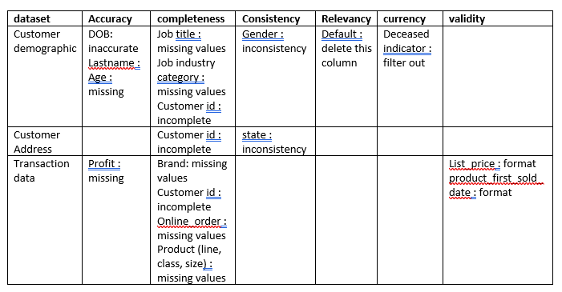
Note: The data and information in this document is reflective of a hypothetical situation and client. This document is to be used for KPMG Virtual Internship purposes only.
Data Exploration
Data Quality Assesment and Clean-Up The Data
Summary table :
Standard Data Quality Dimensions:
Accuracy : correct values
Completeness : Data fields with values
Consistency : Values free from contradiction
Currency : values up to date
Relevancy : data items with value meta data
Validity : data containing allowable values
Uniqueness : Records that are duplicated
*An in depth analysis has been sent via email

Slide 5
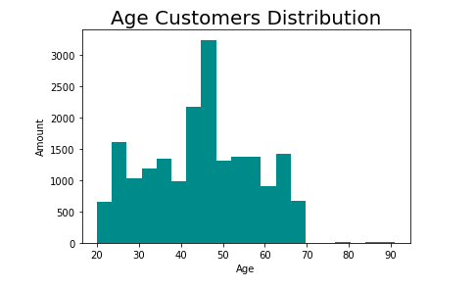
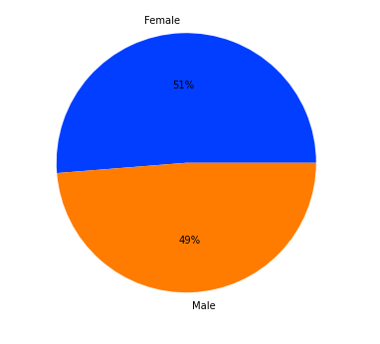
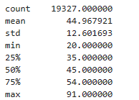
Note: The data and information in this document is reflective of a hypothetical situation and client. This document is to be used for KPMG Virtual Internship purposes only.
Data Exploration
Customer Gender and Age Graphic
The mean of Age customers are 46
The most customers are female with percentage 51%

Slide 6
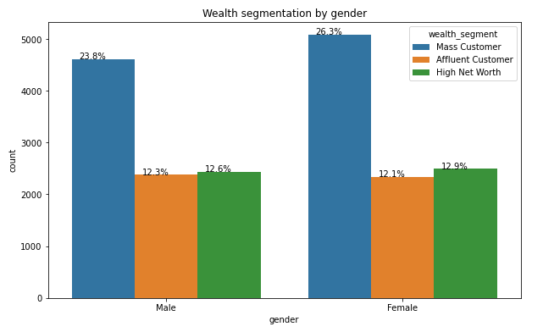
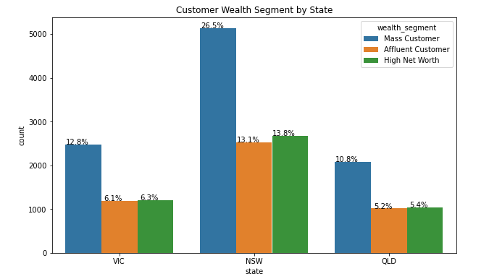
Note: The data and information in this document is reflective of a hypothetical situation and client. This document is to be used for KPMG Virtual Internship purposes only.
Data Exploration
Customer Wealth Segment Graphic by Gender and State
The most state with wealth segment mass costumer is NSW / New South Wales
The most wealth segment is mass costumer.

Slide 7
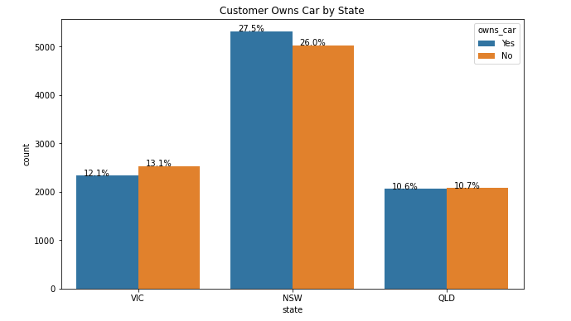
Note: The data and information in this document is reflective of a hypothetical situation and client. This document is to be used for KPMG Virtual Internship purposes only.
Data Exploration
Customer Owns Car Graphic by State
The most state which have customer with the most owns car are NSW or New south Wales with rasio 27.5 %
But NSW also has the largest amount of people who do not own car, but NSW seems to have a higher number from which data was collected .
QLD is also quiet split evenly. But both numbers are significantly lower than NSW.
VIC has a relatively little high number of customers that don’t own car .

Slide 8
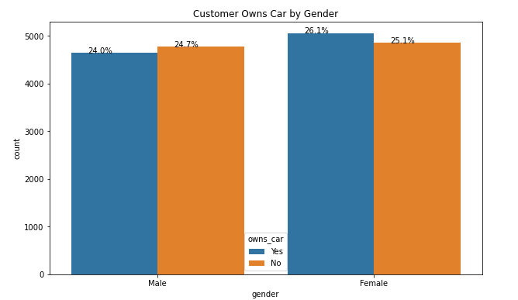
Note: The data and information in this document is reflective of a hypothetical situation and client. This document is to be used for KPMG Virtual Internship purposes only.
Data Exploration
Customer Owns Car Graphic by State and Gender
The most gender who have customer with the most owns car are Female with rasio 26,1 %
But female also has the largest amount of people who do not own car.
Male mostly do not own car

Slide 9
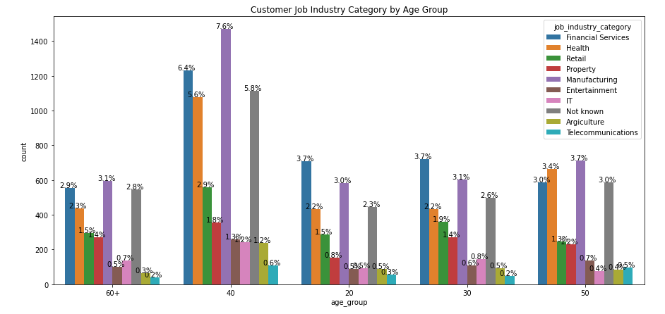
Note: The data and information in this document is reflective of a hypothetical situation and client. This document is to be used for KPMG Virtual Internship purposes only.
Data Exploration
Customer job industry by Age Group Graphic
In all age categories the largest Job Industry of customers are classified Manufacturing with Age group 40 (40-49)
The next category are classified Financial Services with age 40 (40-49)
the third category are classified with age group 30 (30-39)

Slide 10
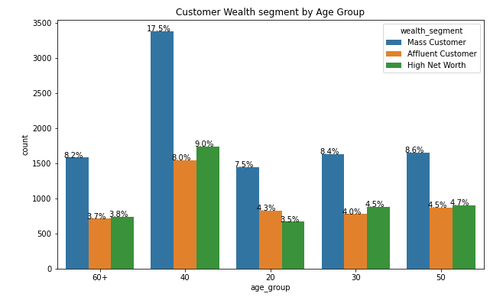
Note: The data and information in this document is reflective of a hypothetical situation and client. This document is to be used for KPMG Virtual Internship purposes only.
Data Exploration
Wealth Segment by Age Group
In all age categories the largest wealth segments of customers are classified with Age group 40 (40-49)
The next category are classified with age 50 (50-59)
the third category are classified with age group 30 (30-39)

Slide 11
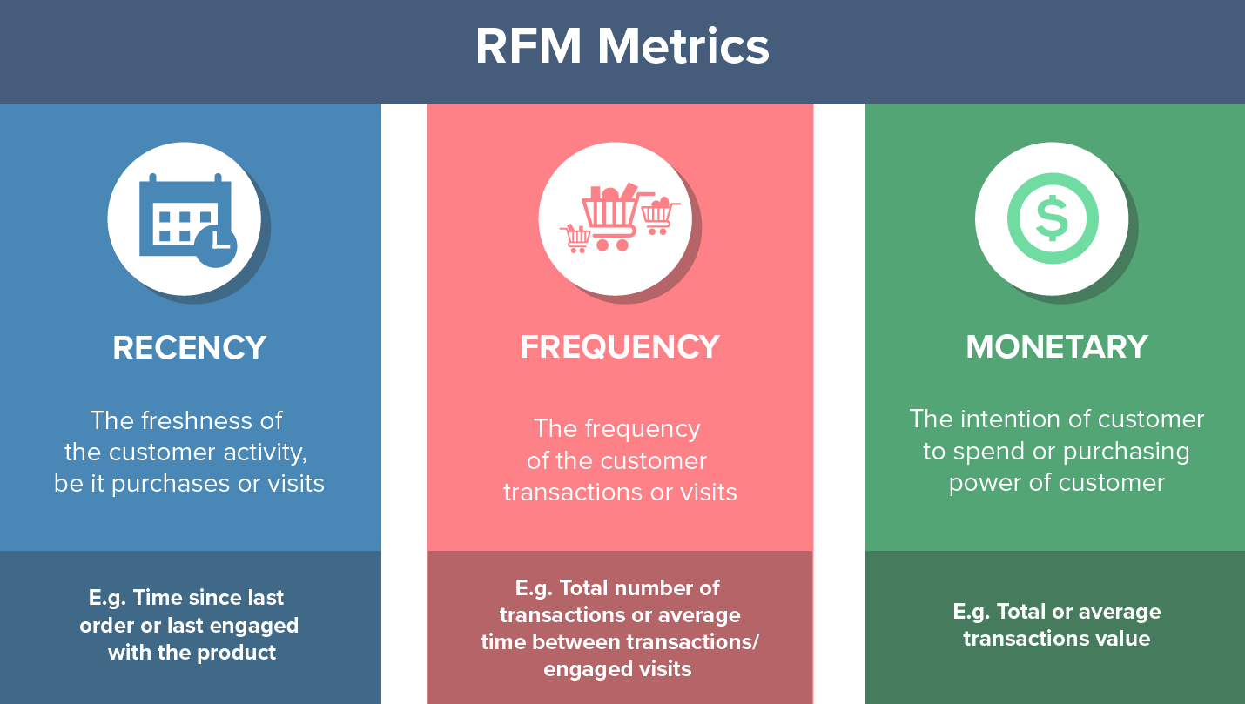
Note: The data and information in this document is reflective of a hypothetical situation and client. This document is to be used for KPMG Virtual Internship purposes only.
Model Development
RFM Analys
RFM analysis is used to determine which customers a bussines should target to increase value or revenue.
RFM (Recency,Frequency, Monetary) model shows customers that have displayed high levels engangement with the bussines in three categories mentioned.

Slide 12
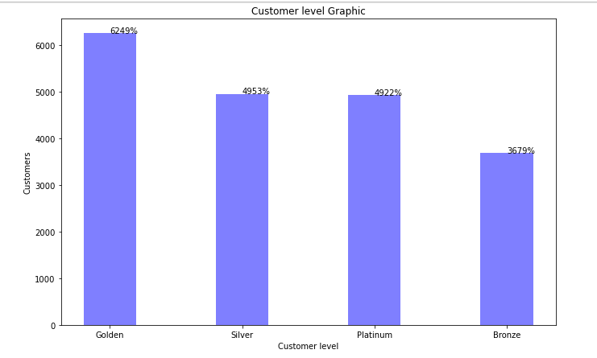
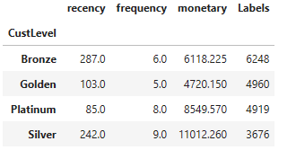
Note: The data and information in this document is reflective of a hypothetical situation and client. This document is to be used for KPMG Virtual Internship purposes only.
Model Development
Customer level classification
Platinum
$8549
85 days
4919
Silver
$11012
242 days
3676
Golden
$4720
103 days
4960
Bronze
$6118
287 days
6248
The highest customer level is golden with rasio 62%

Slide 13
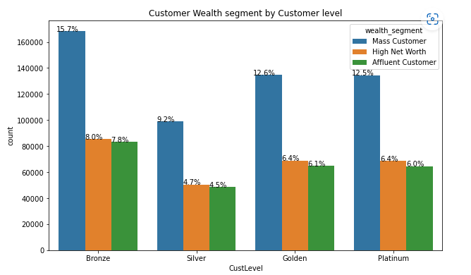
Note: The data and information in this document is reflective of a hypothetical situation and client. This document is to be used for KPMG Virtual Internship purposes only.
Model Development
Customer Level by Wealth Segment
The customer level ‘Bronze’ has wealth segment in mass customer with rasio 15,7%
in second, wealth segment Mass costumer in platinum level of customer with rasio 12,5%
The most highest wealth segment in each customer level is Mass customer.

Slide 14
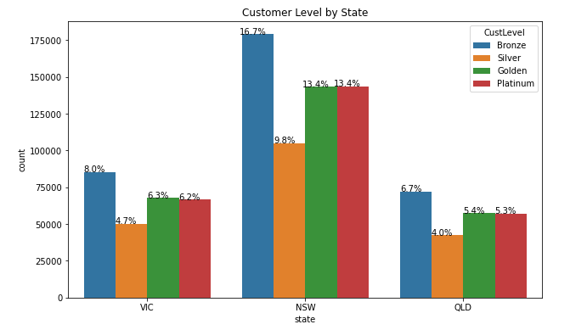
Note: The data and information in this document is reflective of a hypothetical situation and client. This document is to be used for KPMG Virtual Internship purposes only.
Model Development
Customer Level by State
NSW has a highest Bronze customer level with rasio 16,7%
And the platinum with 13,4% , Golden 13,4 % and Silver 9,8%
Then the lowest customer level in QLD with Bronze 6,7%, Platinum 5,3%, Golden 5,4% and Silver 4.0%

Slide 15
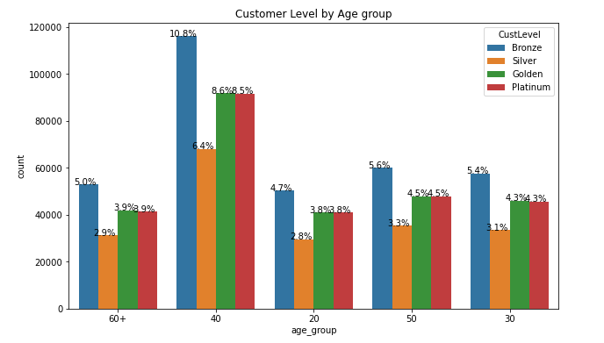
Note: The data and information in this document is reflective of a hypothetical situation and client. This document is to be used for KPMG Virtual Internship purposes only.
Model Development
Customer Level by Age Group
The Age group with the highest customer level Platinum, Bronze, Silver is 40 (40-49)
And the Age group who has the lowest customer level is 60+

Slide 16
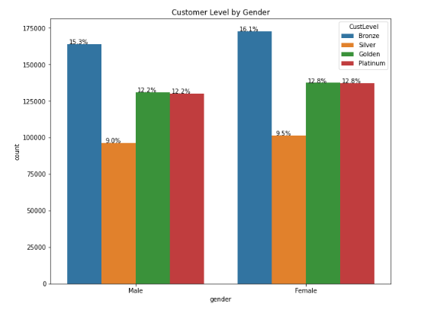
Note: The data and information in this document is reflective of a hypothetical situation and client. This document is to be used for KPMG Virtual Internship purposes only.
Model Development
Customer Level by Gender
Female has the highest of customer level.

Slide 17
Note: The data and information in this document is reflective of a hypothetical situation and client. This document is to be used for KPMG Virtual Internship purposes only.
Interpretation
Rank | Customer Level | Description | Solution
1 | Platinum | Customers who bought most recently,most often, and spent a good mount. | Offer loyalty program or recommend related product to upsell them and help them become loyal customer.
2 | Golden | Customer who purchase quite often, spent a few mount but not frequent shoppers | Start building relationships with these customers by providing onboarding support and special offers to increase their visits.
3 | Silver | Customers who purchase often, and spent a big mount but not recently. | Send them personalized reactivation campaign to reconnect and offer renewals and help product to encourage another purchase.
4 | Bronze | Customers who purchase with spent a good mount, quite frequent but have not been visiting recently. | Bring them back with relevant promotions, and run surveys to find out what went wrong and avoid losing them to a competitor.

Slide 18
Note: The data and information in this document is reflective of a hypothetical situation and client. This document is to be used for KPMG Virtual Internship purposes only.
Appendix

Slide 19
Note: The data and information in this document is reflective of a hypothetical situation and client. This document is to be used for KPMG Virtual Internship purposes only.
Appendix
https://clevertap.com/blog/rfm-analysis/

